Slide 1
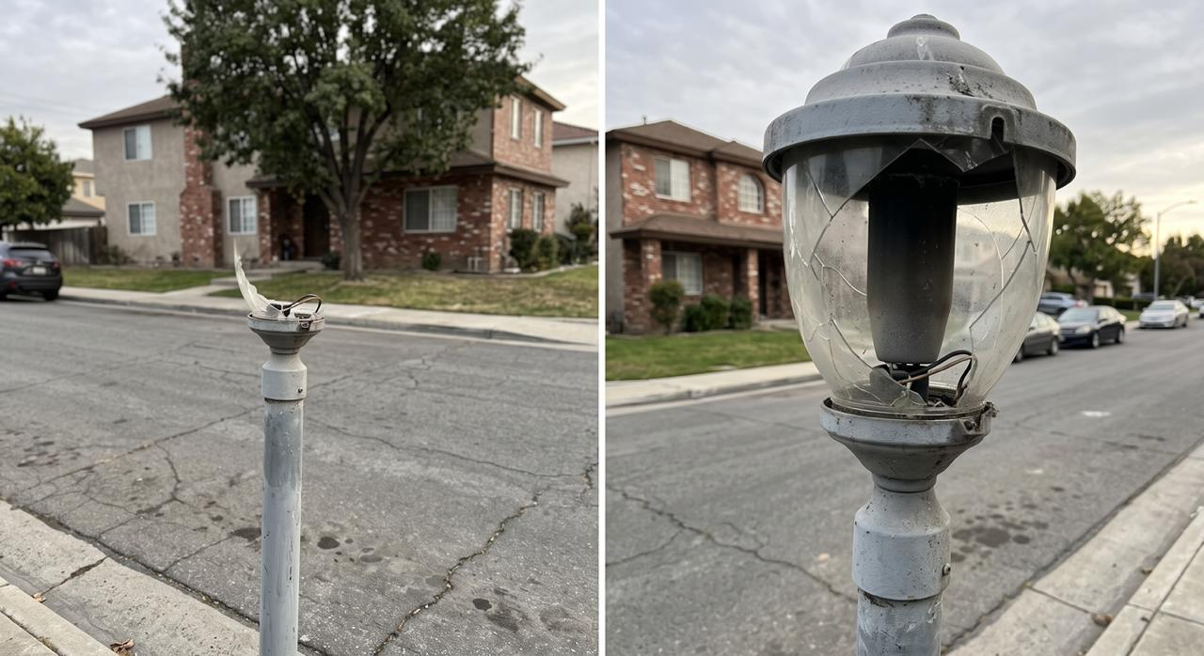

FixMyArea
BUILD FOR IRELAND · DOGPATCH LABS · 4 OCTOBER 2026
A photo and a location become the right next action, using AI and Irish open data.
See → Capture → Understand → Locate → Route → Act
[Team names] · [Project link]
Notes:
0:00 to 0:35. HOOK AND PRODUCT SENTENCE. Point at the photo: "You see this on your street. Who do you tell? Most people don't know, so most problems go unreported." Then: "FixMyArea turns a photo and a location into the right next action, using AI and Irish open data." Read the six-step journey once, then go straight to the app.

Slide 2
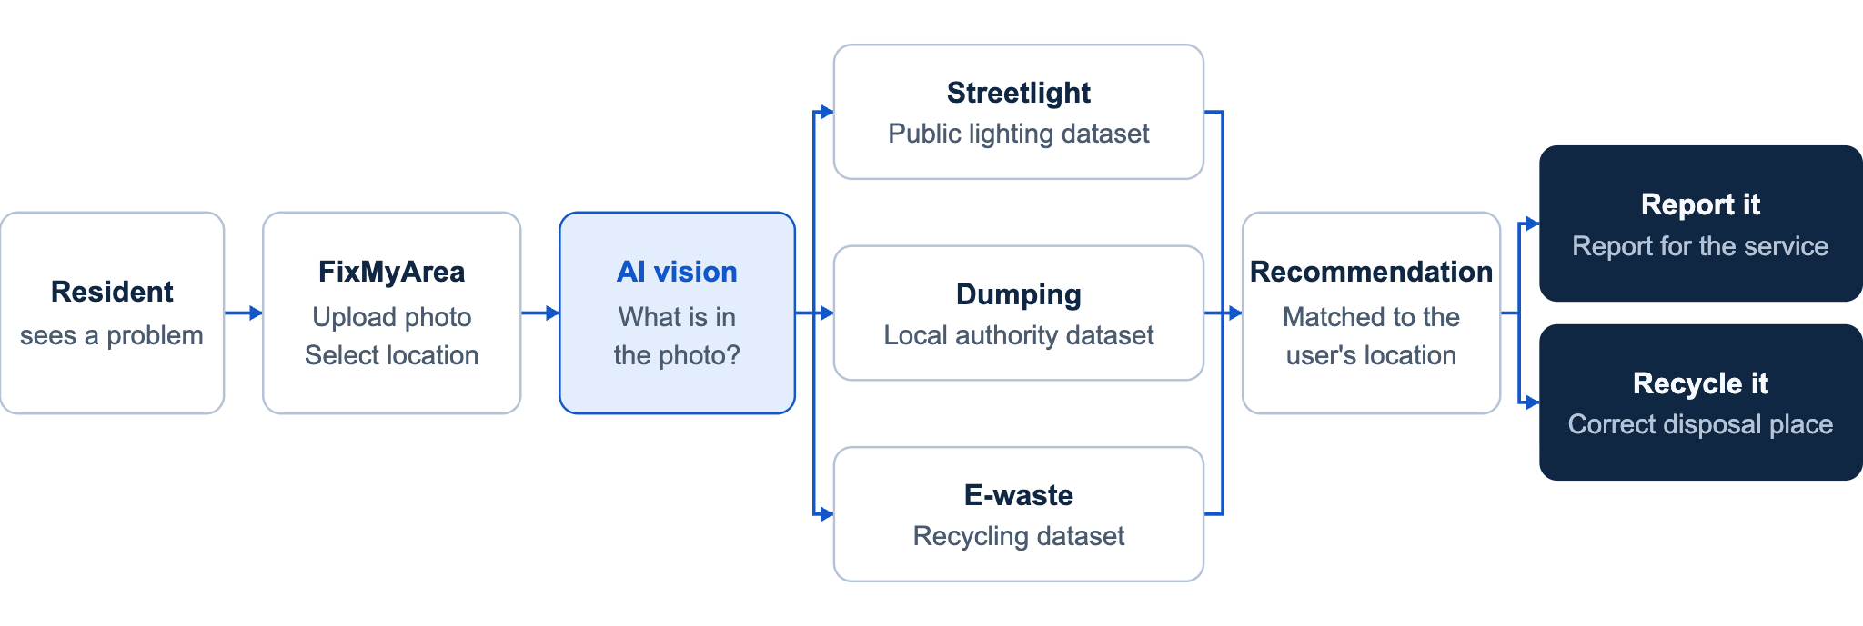
System design: from photo to next action
System design · AI classifies the issue; open data and location decide the result.
Notes:
SYSTEM DESIGN. Walk it left to right in one breath: the resident uploads a photo and picks a location; AI vision classifies the issue; the issue type selects the dataset (public lighting, local authority or recycling); the result is matched to the user's location; FixMyArea recommends the next action, either a report for the right service or the correct disposal place. This slide adds time to the 3-minute run: either keep it to about 15 seconds, or use it in place of the "Each part answers one question" slide, or hold it for technical questions.

Slide 3
Live demo 1: a broken streetlight
1
Upload the photo
WHAT THE RESIDENT SEES
Possible broken streetlight
2
AI labels the issue
Authority
Dublin City Council
3
Drop the pin
Nearest lighting asset
[Asset ID], [__] m away
4
Open data fills in the rest
Next action
Report ready to send
Demo 1 · Report it
Notes:
0:35 to 1:35. LIVE DEMO 1. Switch to the app; this slide is the backdrop and fallback. Upload photo, AI labels it, drop pin, nearest lighting asset and council appear, report ready. Narrate each data hit: "That asset ID is from the council's open dataset." One person talks, one drives. Keep a screen recording and a dated data sample ready in case the network or API fails. Replace the bracketed asset ID and distance with the real values from our demo location.

Slide 4
Live demo 2: same app, a broken laptop
NOT THIS TIME
Council report
INPUT
→
AI SAYS
→
Laptop photo, same pin
Electronic waste
THIS ROUTE
Nearest recycling facility, with directions
A civic routing system, not an image classifier.
Demo 2 · Recycle it
Notes:
1:35 to 2:05. LIVE DEMO 2. Say: "Same app, different problem." Upload a laptop photo at the same pin. The workflow switches: nearest recycling facility and directions instead of a council report. Land the line: "It's a civic routing system, not an image classifier."

Slide 5
Each part answers one question
AI vision
What is it?
Picks from a closed set of issue types
Location
Where is it?
A map pin, as latitude and longitude
Public data
What exists there?
The real asset, council or facility
Verified rules
Where does it go?
The official service or disposal point
FixMyArea
What should I do next?
How it works · The AI never picks the council. Open data and verified rules do.
Notes:
2:05 to 2:30. HOW IT WORKS. Explain what they just watched: AI = what, location = where, data = what exists there, rules = where it goes. Say: "The AI never decides the destination. Verified public data and rules do, so it doesn't hallucinate a council."

Slide 6
Why it matters and what comes next
TODAY
NEXT
Right desk, first time.
More issue types
Potholes and graffiti follow the same pattern.
LATER
More councils
Wherever asset data is published.
Reports arrive with the asset, the location and the right service attached.
HOW
Add datasets and rules, not code
Why it matters · Next
Notes:
2:30 to 2:50. WHY IT MATTERS AND NEXT. More reports reach the right desk first time. The pattern extends to potholes, graffiti and other councils by adding datasets and rules, not code. If asked about limits: Dublin City only today, three issue types, the report is prepared for the resident to send.

Slide 7
"I saw a problem, and now I know exactly what to do."
FixMyArea turns a photo and a location into the right next action, using AI and Irish open data.
FixMyArea · [Team names] · [Project link]
Notes:
2:50 to 3:00. CLOSE. Say the quote as the feeling we want every resident to have, then stop. Leave this slide up during questions. Likely questions: how accurate is the classification, what happens when it is unsure (it says so and asks, it does not guess), and does it submit to the council (no, it hands off to the official service).

Slide 8
Irish public data does the deciding
SOURCE | QUESTION IT ANSWERS | WHAT THE RESIDENT SEES
DCC Public Lighting | Which light is this? | Asset ID and distance
Local Authority Boundaries | Which council covers this point? | Responsible authority
Recycling centres | Where can this item go? | Nearest facility and directions
Routing rules (curated by us) | What is the official next step? | Link to the right service
Data-backed facts and AI suggestions are labelled separately in the app.
Backup · Data · Sources: [dataset links and update dates from data.gov.ie / Dublinked]
Notes:
BACKUP, not in the 3-minute run. Use for questions. The brief asks us to name the data, so name it explicitly and credit the providers. Key line: "The data is used inside the product, not just visualised." Be honest that the routing table is our own curated file, checked against official council pages. Fill in the real dataset titles, links and update dates before submitting.

